Slide 1
Metabolism & ATP (Part 2 of 2)
Lecture 14

Slide 2
Objectives
Describe the structure, conformational states and reproduction of mitochondria. Compare between inner & outer membranes structure of the mitochondria
Describe BRIEFLY the Krebs cycle and list its products
Describe BRIEFLY the electron transport system/chain and list its product
Describe the breakdown of ATP production per one glucose usage (the total ATP accounting)

Slide 3
Metabolism Re-Overview
Glucose breakdown & ATP production (cellular respiration) shown in equation in previous lecture is complex process involving three main pathways:
Glycolysis, occurring in cell cytoplasm
TCA (Krebs) cycle, occurring in mitochondria
Electron transport system/chain & oxidative phosphorylation, also occurring in mitochondria
From ONE glucose molecule, the three pathways will produce a total of 36 ATP molecules:
2 from glycolysis
2 from Krebs cycle
32 from electron transport system

Slide 4
Mitochondria
The "powerhouse of the cell": that is, where most ATP production occurs
0.5-1 μm diameter, about 7 μm long (RBC diameter) but variable in size and shape
Range from 100 to several thousand in number, depending on cell's metabolic activity

Slide 5
Mitochondria As "Organism"
Mitochondria have a single, circular ds DNA similar to bacteria, including the DNA polymerases to replicate the DNA and the RNA polymerases to transcribe the few genes
Mitochondria also have ribosomes, so they can translate the proteins of the transcribed genes
They are not autonomous organisms however, since they must import proteins from the proteins coded by cell's nucleus to function
Mitochondria were once thought to be intracellular symbionts of the first eukaryotic cell
All mitochondria are inherited from the mother, since sperm do not infuse the fertilized egg with the organelle

Slide 6
Mitochondrial Structure
matrix
has all soluble enzymes for Krebs cycle as well as DNA and ribosomes of mitochondria
inner membrane
contains all the electron transport system components to generate ATP
intermembrane space
space between outer and inner membrane
it will accumulate protons to drive ATP generation
outer membrane
a highly porous membrane that encloses the organelle
crista
inward invaginations of the inner membrane that increase surface area to permit large amounts of ATP production

Slide 7
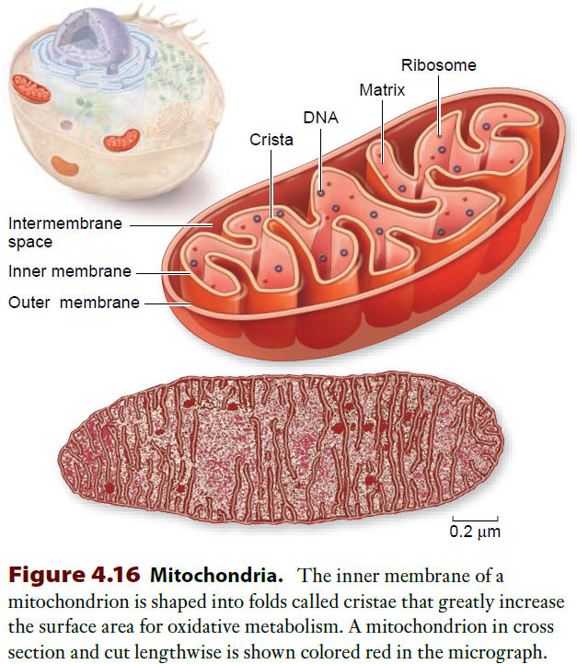
This figure shows
mitochondria relative to size and location in the cell
the basic cross section of the organelle
schematically
in an electron micrograph

Slide 8
TCA (Krebs) Cycle Important Steps 1 of 2
Reaction 1—2-carbon acetyl-CoA formed from pyruvate oxidation enters the cycle and combines with 4-carbon oxaloacetate coming out of the end of the cycle to form 6-carbon citrate
the energy for condensing these two compounds comes from Coenzyme A bond breaking; CoA goes back to PDHase reaction
Reactions 3-4—one CO₂ molecule is generated in each of these oxidative decarboxylation reactions (total two CO₂ molecules): 6C → 5C → 4C
NAD⁺ is reduced to NADH + H⁺ in each of these two reactions, which will later make ATP

Slide 9
TCA (Krebs) Cycle Important Steps 2 of 2
Reaction 5—a substrate-level phosphorylation step: GDP is phosphorylated to GTP; GTP can phosphorylate ADP to make ATP
consider this to be a substrate-level phosphorylation reaction to make ATP
Reaction 6—Another oxidation (dehydrogenation) step. The redox potential of (energy from) this step is not great enough to use NAD as electron acceptor: FAD is electron acceptor instead, reduced to FADH₂ (has lower redox potential)
Reaction 8—Another NADH-generating oxidation step, and the final step of the cycle, generating oxaloacetate to go back to step 1

Slide 10
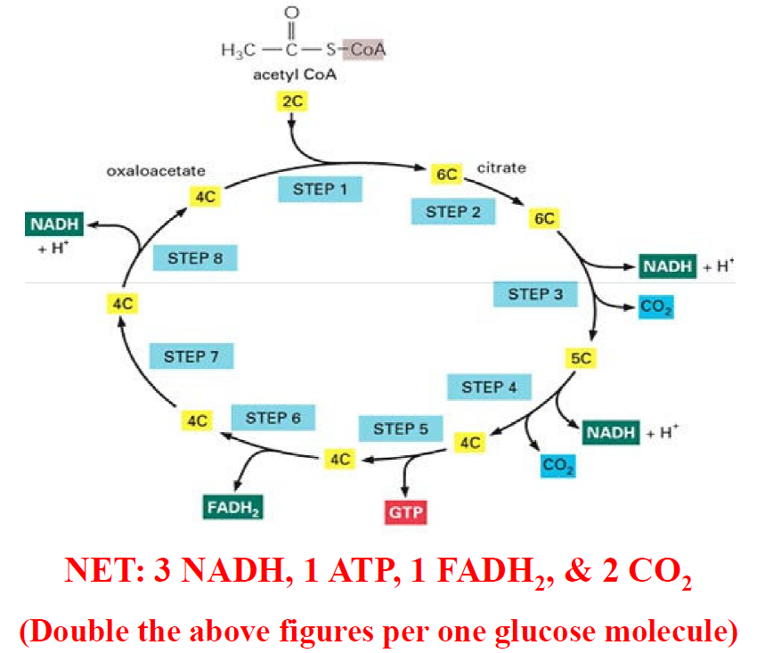
TCA Cycle

Slide 11
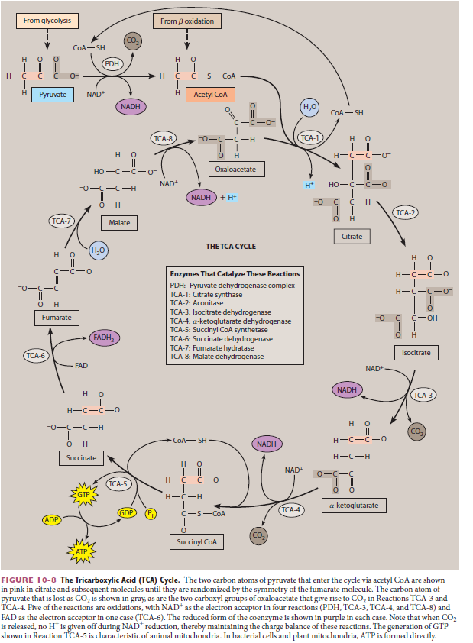
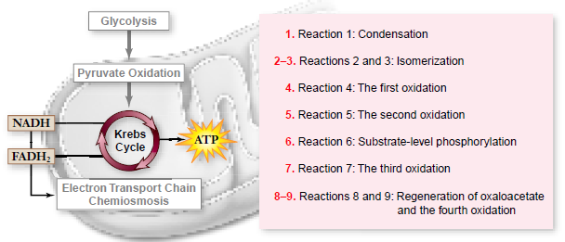
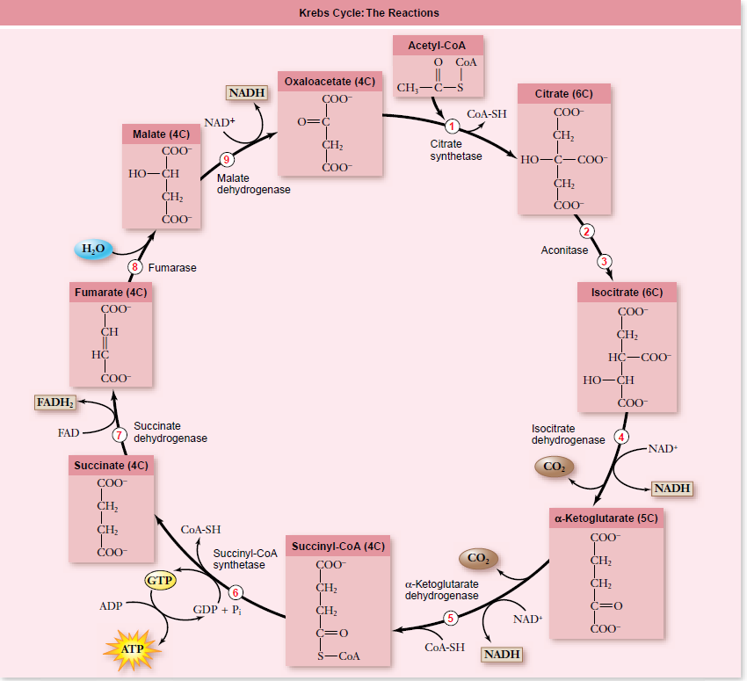

Slide 12
Summary
Oxygen is required for TCA cycle to proceed
This is a cyclical series of reactions that give off CO₂ and produce one ATP in the cycle itself
Two turns of the cycle per glucose molecule→ produces two ATP molecules from the cycle itself
ATP is produced by substrate level phosphorylation
Krebs Cycle Summary
takes place in matrix of mitochondria.
Each turn of the Krebs Cycle also produces three (3) NADH, one (1) FADH₂, and two (2) CO₂ molecules, so two turns double these numbers for one (1) glucose molecule

Slide 13
Electron Transport System
Also called electron transport chain
These are complexes of proteins and lipophilic molecules that are embedded in the mitochondrial inner membrane
They will take the reduced coenzymes, NAD and FAD, produced from glycolysis and Krebs cycle and will oxidize (take electrons) from them
A series of oxidation-reduction reactions will take place—electrons being passed from one component to another
These succession of oxidation-reduction reactions will vectorially move protons (H⁺ ions) across the mitochondrial inner membrane, generate a concentration difference that will drive ATP generation

Slide 14
Oxidation-Reduction Reaction
red = reduced, ox = oxidized
here's an example reaction
ETS-1_{red} + ETS-2_{ox} → ETS-1ox + ETS-2red
Now here's how the reaction is broken into two half-reactions
ETS-1_{red} → ETS-1_{ox} + 2 e– + 2 H⁺
ETS-2_{ox} + 2 e– + 2 H⁺ → ETS-2_{red}
These half-reactions importantly show how protons are released and consumed in the process
In oxidation, with release of H⁺, H⁺ are released from the inner membrane into the intermembrane space
In reduction, with consumption of H⁺, H⁺ are taken from the matrix into the inner membrane

Slide 15
ETS Energetics
Electrons from NADH are passed along a chain of electron acceptors in turn
Each electron acceptor has a lower "redox potential" (potential energy) than one component before it in chain
Certain series of reactions have enough energy to power production of 1 ATP molecule
These ETS components, in order, are NAD → CoQ → cytochrome → oxygen (O₂): 3 ATP per NAD
Other ETS path is FADH₂ → cytochrome → O₂: 2 ATP per FADH₂

Slide 16
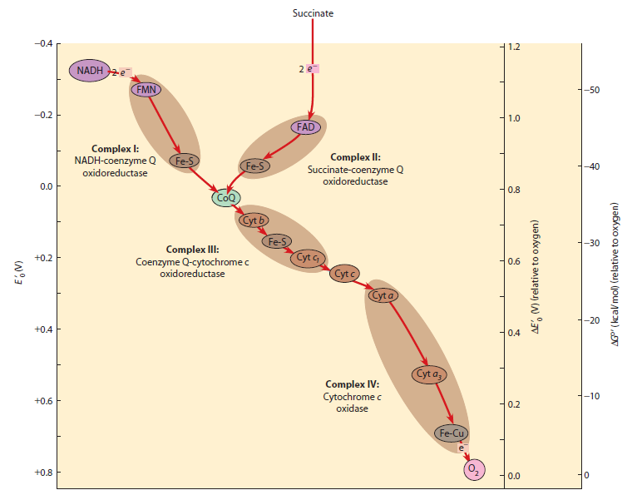
ETS Energetics
This shows how the products how NAD and FAD from Krebs + glycolysis enter the electron transport system and how a chain of oxidation-reduction reactions occur with the relative change in energy between reactants and products

Slide 17
The Mitochondrial F₀ ATPase
We will learn how mitochondria provide metabolic pathway components (enzymes) to transfer chemical bond energy to ATP
But relevant to the discussion of "active transport" in which ATP is utilized by ATPase proteins to move ions and molecules against their concentration gradient, we discuss how one special protein in the membrane of the organelle mitochondria uses a concentration gradient to make ATP
In other words, this is the REVERSE process: ions on the high concentration of a membrane move across to the low side, and this energy (chemical potential) drives the synthesis of ATP!

Slide 18
Reverse of Active Transport?
If ATP can be used move ions/molecules against a concentration gradient, why can't the process be reversed to make ATP instead?
This is what happens with ATP production by the mitochondrial F₀ (F-type) ATPase: ATP is made by condensing ADP and inorganic phosphate (P_{i} or HPO₄^{2–})

Slide 19
The Mechanism
Ion Concentration Difference. In the mitochondria, the electron transport system (ETS) generates a concentration difference in protons (H⁺) is made across the inner membrane of mitochondria
the ETS is discussed in the next lectures: the only important thing to know at this point is that an H⁺ concentration difference is generated by it
The H⁺ concentration difference is then used to drive the synthesis of ATP

Slide 20
Chemiosmotic Gradient
The ETS therefore is pumping H⁺ ions from one side of the inner membrane to the other (from matrix → intermembrane space), building up a H⁺ concentration difference (also called the chemiosmotic gradient)
Recall that Na⁺ ion concentration differences across a membrane are produced by using ATP, and these Na⁺ concentration differences can be used to do other kind of cellular work, particularly coupled transport
This proton (H⁺) concentration difference across the inner membrane will be used to produce ATP itself

Slide 21
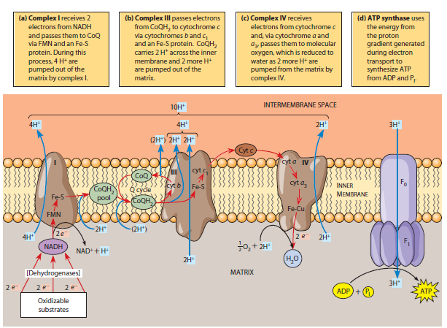
Electron Transport System
NADH produced in glycolysis and Krebs cycle is oxidized back to NAD by proteins in Complex I (NADH dehydrogenase)
Electrons are then moved to the cytochromes and Fe-S proteins in Complex III through quinone (CoQ) molecules in the membrane
Cytochrome c gets reduced (i.e., gets electrons) from last protein Complex III chain, and reduces in turn the Complex IV (cytochrome c oxidase)
With each oxidation-reduction, H⁺ gets moved across the membrane
The buildup of H⁺ is used by ATP synthase to produce ATP

Slide 22
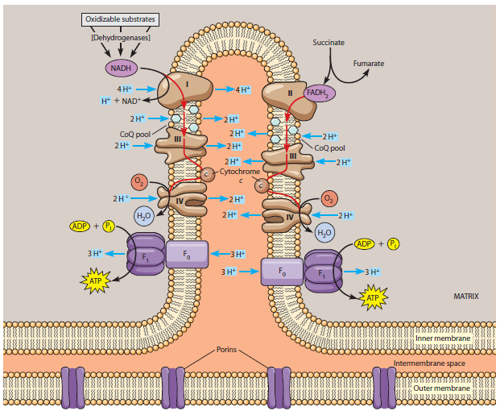
This is the same ETS as shown previously, but location of the complexes are shown as part of the larger mitochondrial structure

Slide 23
Inputs to ETS
From Krebs Cycle (two turns for 1 glucose)
6 NADH → 3 ATP / NADH = 18 ATP
2 FADH₂ → 2 ATP / FADH2 = 4 ATP
From pyruvate → acetyl-CoA
2 NADH → 3 ATP / NADH = 6 ATP
From glycolysis
2 NADH → 3 ATP / NADH = 6 ATP

Slide 24
Summary of ETS
34 ATP produced by oxidative phosphorylation
Proton (H⁺) concentration difference across inner membrane generated by oxidation-reduction reactions with vectorial movement from matrix → intermembane space
H⁺ concentration difference drives ATP production with ATP synthase membrane protein
O₂ accepts electrons at last step to make H₂O molecules
Uses coenzymes NAD⁺ and FAD to accept electrons from the breakdown of glucose

Slide 25
Full Accounting of ATP Made
Grand total ATP from ONE glucose
+2 ATP from glycolysis
+2 ATP from Krebs cycle (via GTP)
+ 34 ATP from ETS
= 38 ATP
HOWEVER, transport of NADH generated by glycolysis from cytosol → matrix of mitochondria requires using ONE ATP per NADH, so we lose 2 ATP for NET 36 ATP
In reality only 30 ATP are generated from one glucose because of H+ leaking and other coupled energy processes

Slide 26
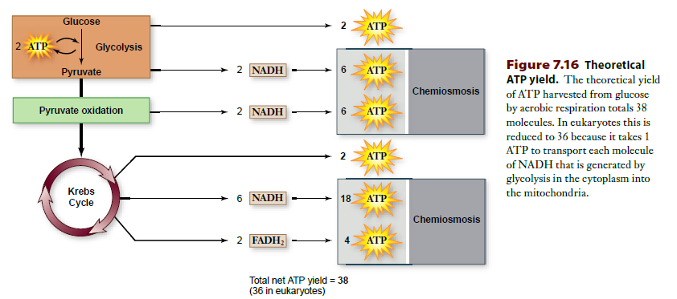

Slide 27
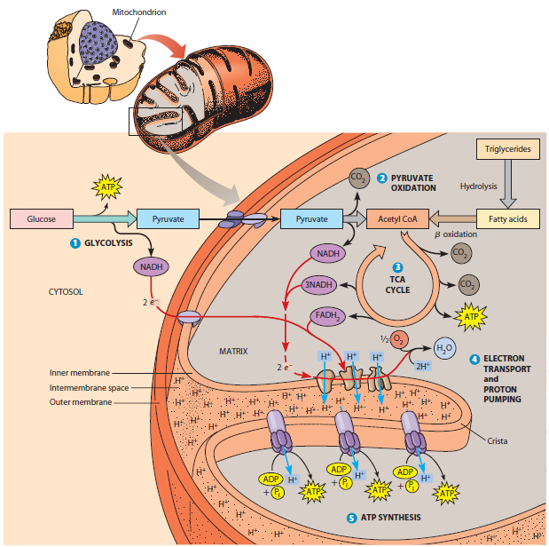

Slide 28
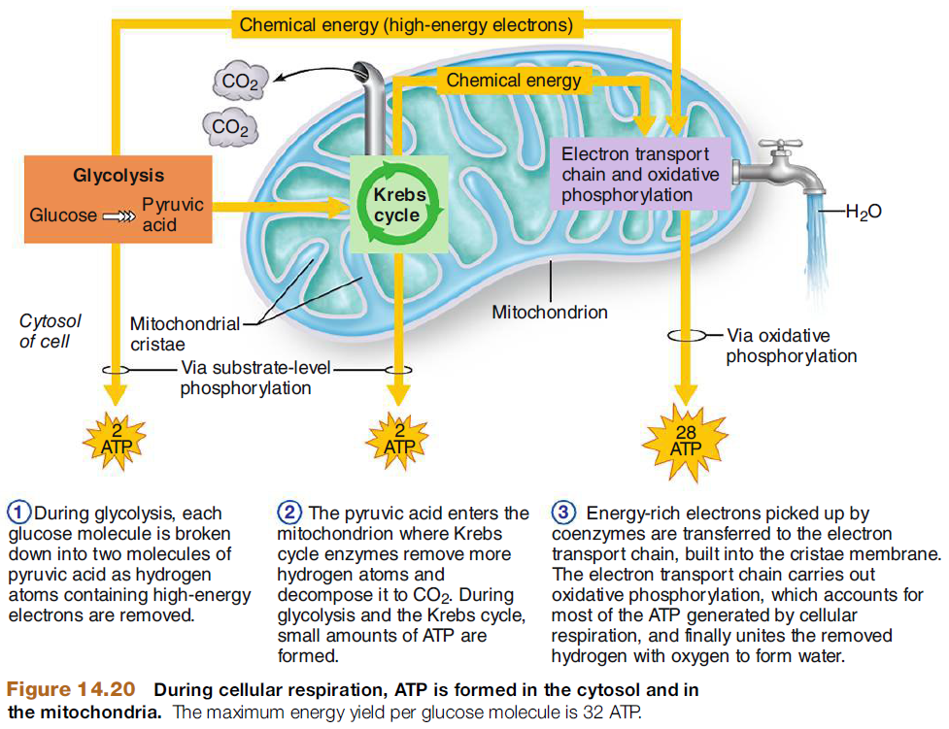

Slide 29
Reading
The reading is the same for Lectures 13 & 14
Becker's WotC: 224-236, 252-263, 267-272, 274-288
Raven: pp 108-110, 112-113, 117-119, 123-138

